Slide 1

Low Power 4T SRAM Cache
Project guide : Kirti S Pande
Department : ECE
Date :18 May, 2013
Team members
Sai Sundeep I BL.EN.U4ECE09048 Marri Revanth BL.EN.U4ECE09532 Nikhilanjali J BL.EN.U4ECE09536

Slide 2
Overview
Introduction
Objective
6T SRAM - Design considerations
4T SRAM - Introduction and Operation
Design considerations of 4T SRAM
Cache architectures of 6T and 4T
Divided bitline technique
Simulations and Results
Conclusion
Future scope

Slide 3
Introduction
Cache memory is a smaller and faster memory
Stores copies of the data from the most recently used main memory locations
Average delay of memory accesses will be closer to the cache delay than to the delay of main memory
Cache memories are implemented using SRAMs
Generally implemented using 6T SRAMs

Slide 4
Objective
Implementation of cache memory using 4T SRAM and compare with 6T
Modifying the architecture of cache memory to reduce the delay introduced by 4T SRAM
Proving 4T SRAM can be used to attain low power without much compromise in delay

Slide 5
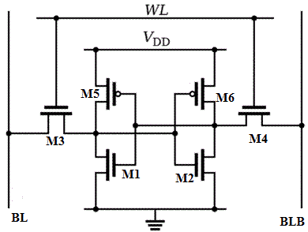
6T SRAM

Slide 6
Design Considerations of 6T SRAM
Two basic requirements dictate W/L ratios
Let us consider two operations
Read “0” operation
Write “0” operation when “1” is stored
Read operation should not destroy the stored information
Cell should allow modification of stored information during write operation

Slide 7
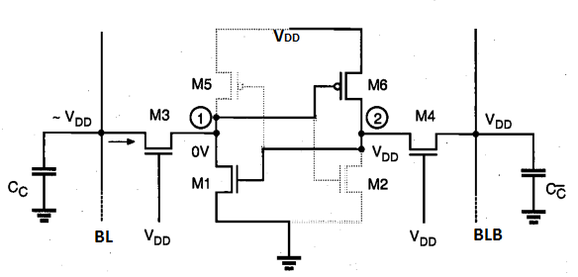
Read “0” Operation

Slide 8

Read “0” Operation
Key design concept
M3 operates in saturation region and M1 operates in linear region
Current flowing through both the transistors is equal

Slide 9

Read “0” Operation
Symmetrical conditions dictate aspect ratios of M2 and M4
Substituting VDD = 0.5V and VT = 0.2V, we get
W3 < 8(W1), W4 < 8(W2)
From layout W1=W2= 9 λ, hence
W3<72 λ and W4< 72 λ

Slide 10
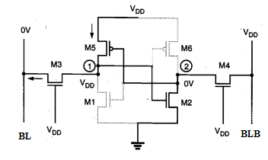
Write “0” Operation

Slide 11

Write “0” Operation
As per previous design considerations, V2 < VT,1 and hence doesn't turn on M1
To change stored information reduce V1 below threshold voltage of M2
When V1=VT,n M3 operates in linear region and M5 operates in saturation region

Slide 12

Write “0” Operation
M1 subsequently turns ON, changing the stored information
Symmetrical condition dictates the aspect ratios of M6 and M4
Substituting VDD=0.5V, VT=0.2V and µn/µp ~ 2.5 we get
W3 > 2.45 (W5) and W4 > 2.45 (W6)
From layout W5 = W6 = 5λ, hence we obtain
W3 > 12.25 λ and W4 > 12.25 λ

Slide 13
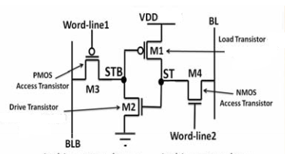
4T SRAM

Slide 14
4T SRAM
BL and BLB are pre-charged to GND and V_{DD} respectively
When ‘1’ is stored in cell load and drive transistors are ON
When ‘0’ is stored in cell
Load and drive transistors are OFF
For data retention without refresh cycle following conditions must be satisfied
Ioff-NMOS-access > ISD-Load + IGate-Driver + IGate-Load
Ioff-PMOS-access > IDS-Driver + IGate-Driver + IGate-Load

Slide 15
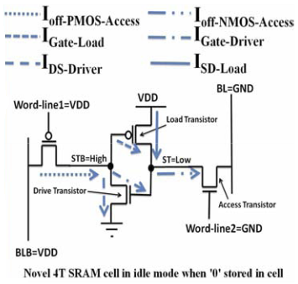
4T SRAM

Slide 16
Read Operation
Bit-line Pre-charging | Word-line activation | Sensing | Idle mode
BL pre-charged to GND and then floated No dynamic energy consumption is involved | When voltage of ST node is low The voltage of BL and ST node equalized Power consumption is very small When voltage of ST node is high, the voltage of BL pulled up to high voltage V_{BL-HIGH} | The sense amplifier is enabled to read data on BL | At the end of read operation cell goes to idle mode WL2 and BL are asserted to GND

Slide 17
Write Operation
Bit-line driving | Cell flipping | Idle mode
Pre-charge on BL is turned OFF and data to be written is placed on BL Voltages on WL1 and BLB are maintained at idle mode | When data is logic ‘0’ ST node is pulled down to GND by NMOS access transistor Load and Drive transistors are OFF STB node is pulled up to high voltage by leakage current of PMOS access transistor When data is logic ‘1’ Drive transistor is ON which further turns ON the load transistor ST and STB nodes are pulled to V_{DD} and GND respectively | At the end of write operation cell goes to idle mode WL2 and BL are asserted to GND

Slide 18
Design Considerations of 4T SRAM
Key issues to be considered
1
Leakage currents of access, load and drive transistors
2
Power consumption

Slide 19

Leakage currents
Sub-threshold leakage current between source and drain occurs when gate voltage is below V_{T}
As threshold voltage increases, sub threshold leakage current decreases
Gate oxide tunneling current results due to tunneling of electrons from substrate to gate and vice versa, through the gate oxide
It occurs due to reduction of gate oxide thickness and increase in the field across the oxide

Slide 20
Body Effect
Leakage currents depend on threshold voltage of a transistor
Threshold voltage can be changed by changing the body bias voltage
This is achieved by changing N-well voltages
N-well voltage for load transistor is increased which results in increase of its threshold voltage
N-well voltage for PMOS access transistor is decreased which results in decrease of its threshold voltage

Slide 21
Body Effect
When the threshold voltage is increased, current I_{DS} in saturation region will decrease
Current equation in saturation region is given by
I_{DS} = (Kn′W/L)[VGS-VT]²
If the bit line capacitance is large, more current is required to pull the bit-line to the value stored in cell
Hence there exists a trade-off between the body biasing voltage and delay in reading “1”

Slide 22
Reduction in Power Consumption
VDD is reduced to 0.45V and Vss is increased to 0.05V
Bitline swing reduces which results in reduction of power consumption
In hold “0” case, VGS of load transistor falls below zero due to which leakage currents become negligible

Slide 23
Cache Architecture
Basic architecture of SRAM memory array comprises of the following components
Dual core
Row decoder
Column decoder
Precharge circuit
Read/ Write circuitry

Slide 24
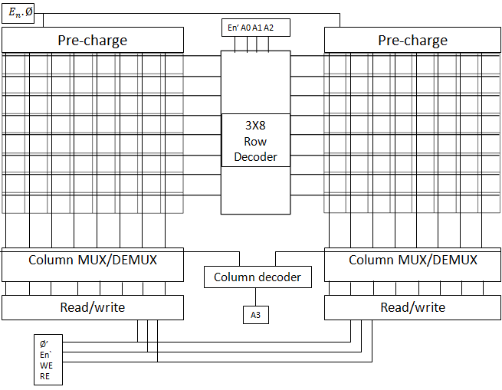
Block Diagram

Slide 25
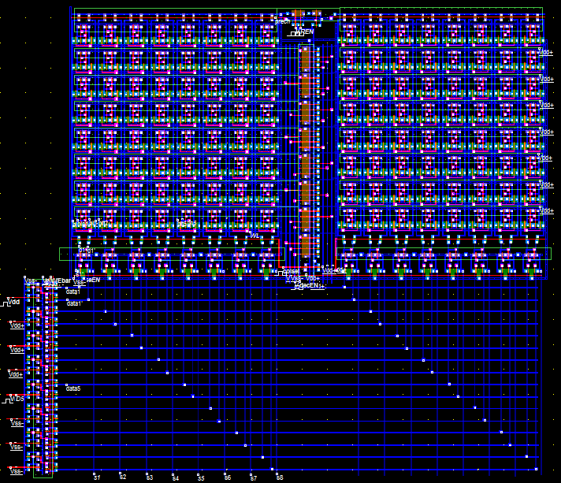
6T Cache Layout (8x16)

Slide 26
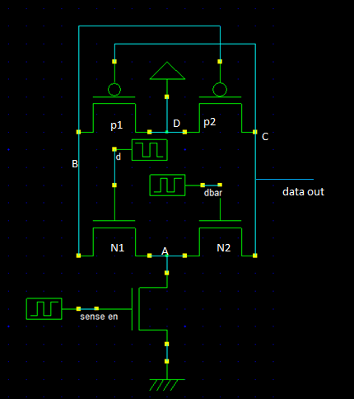
Schematic of 6T Sense Amplifier
When sense en = ‘1’ node A is grounded
If d = ‘1’ node B is pulled to GND which activates P2
Node C is pulled to VDD which comes as data out
If d = ‘0’ , dbar =‘1’ and dataout is pulled to GND
When sense en = ‘0’ irrespective of value of d, dout is in high impedance state

Slide 27
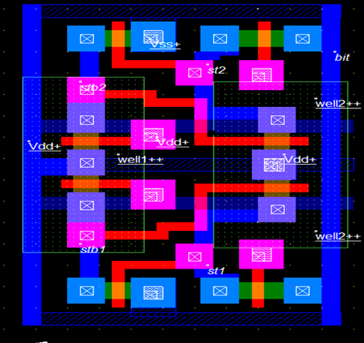
Layout of 4T Cells

Slide 28
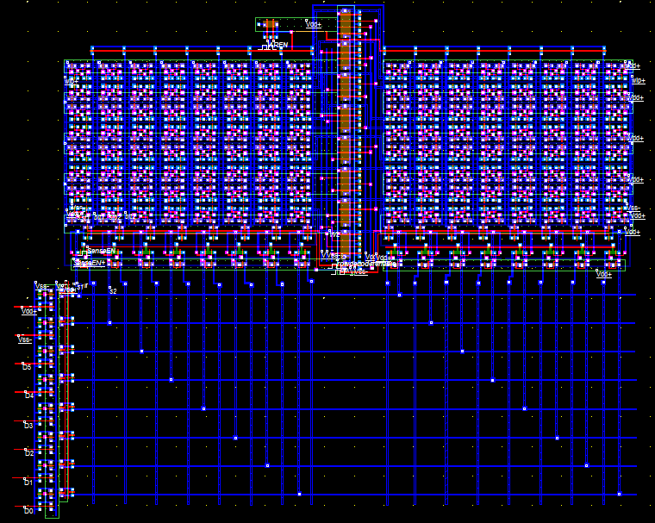
4T Cache Layout (8x16)

Slide 29
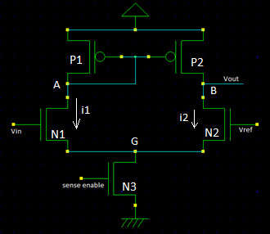
Schematic of 4T Sense Amplifier
When sense en = ‘1’ node G is grounded
If Vin > Vref , then Vout = V_{DD}
If Vin < Vref , then Vout = 0
When sense en = ‘0’ irrespective of Vin value, Vout is in high impedance

Slide 30
Divided Bitline Technique
Delay reduction in 4T SRAM cache is achieved using divided bit-line technique
Bit-line is divided into several local bit-lines and a global bit line
Two or more SRAM cells are combined together to form a sub group
They are in turn connected to global bit-line through NFET or TG
Grouping reduces the capacitance offered, as drain capacitance and metal length reduce

Slide 31
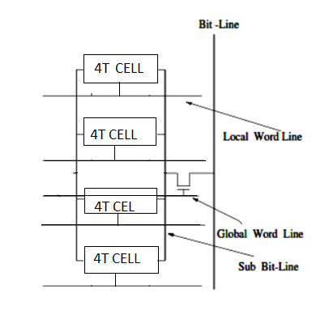
Divided Bitline Technique

Slide 32
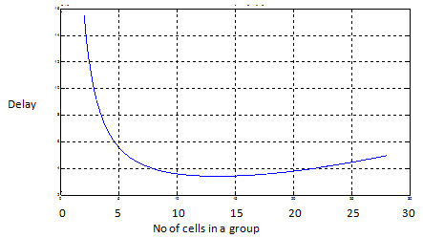
Variation of Delay with change in grouping
T_{d} = [N*C_{m}/2+(N/m)C_{d} ]*[ N*R_{m}+(N/M)R_{d} ]
+ [ ( M+2)C_{d} +(M+2)C_{m} ]*[ (M+2)R_{d} + (M+2)R_{m} ]
The above equation is plotted in MATLAB and the value of m giving minimum delay is found from the above graph

Slide 33
Single Cell Comparisions
Parameter | 6T | 4T
Avg. Write power | 0.551µW | 0.349µW
Avg. Read power | 0.198µW | 0.171µW
Avg. Static power | 0.114µW | 0.0995µW
Cell delay(write 1) | 0.02nS | 0.034nS
Cell delay(write 0) | 0.013nS | 0.065nS
Write power and read power are less by 36% and 10.5%
Static power is less by 13%
Delay for write ‘1’ is 70% more and for write ‘0’ its five times

Slide 34
Cache Comparisons
Parameter | 6T SRAM Cache | 4T SRAM Cache
Avg. Write power | 25.6µW | 14.49µW
Avg. Read power | 42µW | 12.25µW
Avg. static power | 13.743µW | 16.495µW
Avg. write delay | 0.093nS | 0.096nS
Avg. Read delay | 0.074nS | 0.096nS
For 4T SRAM Cache
Average write and read powers are less by 44% and 71% respectively
Average static power is more by 20% due to the excess power consumed by sense amplifier

Slide 35
Cache Comparisons
In case of read ‘1’ the maximum access delay of 4T cache is 0.2nS where as for 6T cache it is 0.106nS
This reduces the maximum frequency at which 4T cache can be operated
Hence this access delay has to be reduced

Slide 36
Comparison of Single bitline 4T and Divided bitline 4T
Parameter | Single bit line | Divided bit lint
Avg. Write power | 17.164µW | 15.75µW
Avg. Read power | 16.027µW | 16.54µW
Avg. write delay | 0.236nS | 0.22nS
Avg. Read delay | 0.28nS | 0.21nS
Power delay product (Write) | 4.05 | 3.465(14.5)
Power delay product (Read) | 4.51 | 3.47(23)

Slide 37
Comparison of Single bitline 4T and Divided bitline 4T
By implementing divided bit line technique on 4T
Power delay product for write cycle is improved by 14.5% and for read cycle improvement is 23%
Maximum delay in the case of read '1' is reduced by 52.5%
Hence low power 4T cache memory can be designed without much compromise in operation speed

Slide 38
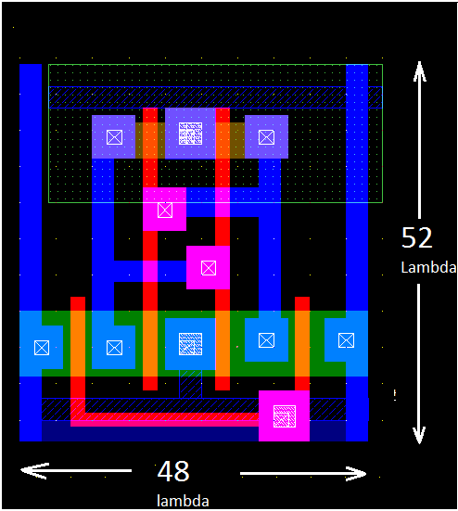
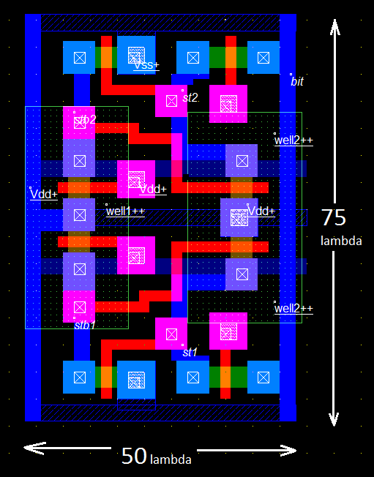
Area Comparison of 6T and 4T cells
Layout of 6T SRAM Cell
Layout of two 4T SRAM cells

Slide 39
Area Comparison of 6T and 4T cells
Parameter | 6T Cell | 4T Cell
Area | 2496 λ² | 1875 λ²
Area of 4T Cell is 75% of 6T cell
Area reduction of 25% is achieved

Slide 40
Conclusion
4T SRAM consumes less power but has more delay when compared to 6T SRAM
Reduction in power is about 30% and increase in delay is 70%
Access delay of the 4T SRAM cache is twice the delay of 6T SRAM which limits the operating frequency
Application of divided bitline technique reduces the delay
Power-delay product is reduced by about 14.56% and 23% in write and read cycles respectively

Slide 41
Future Scope
If a high end tool is used to change the thresholds of load and drive transistors, a single N-well can be used which will save area up to 50%
Row drivers can be used to drive large word line capacitances
Two or more row decoders can be used to control word lines from both sides of core thereby reducing the delay

Slide 42
Thank you

Slide 43
Questions?

